Slide 1
Spatial Transcriptomics
9 April 2025

Slide 2
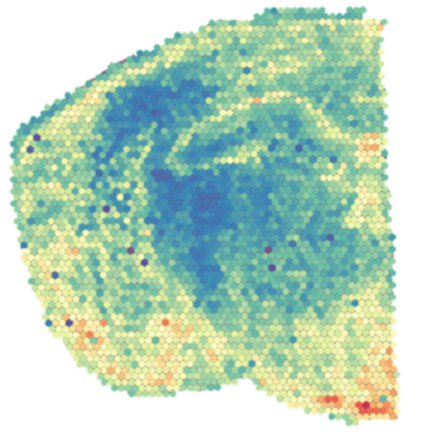
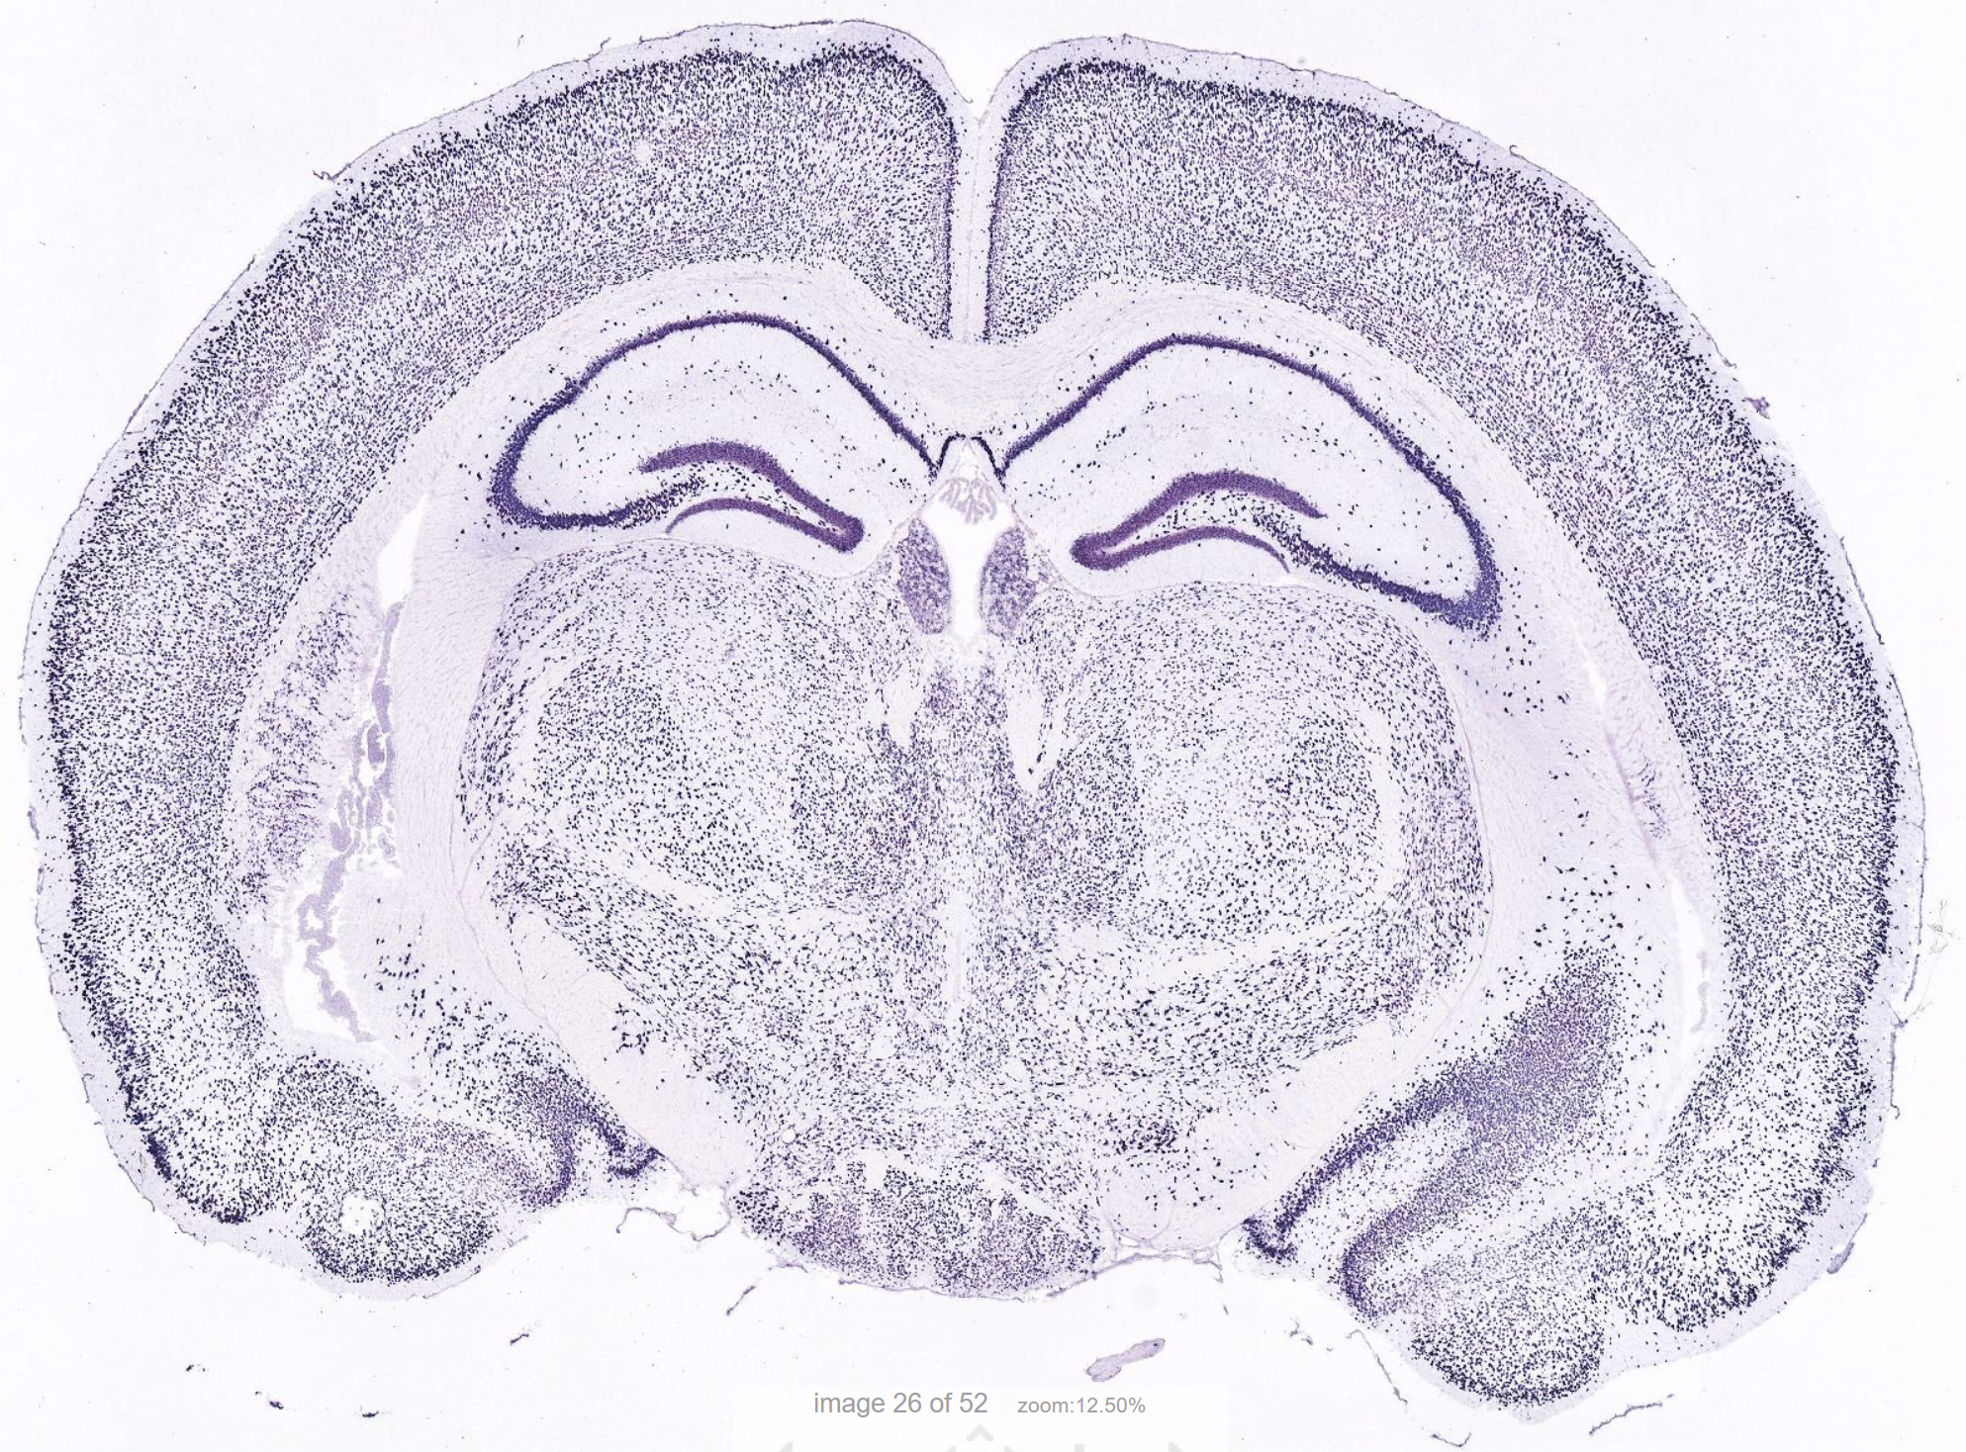
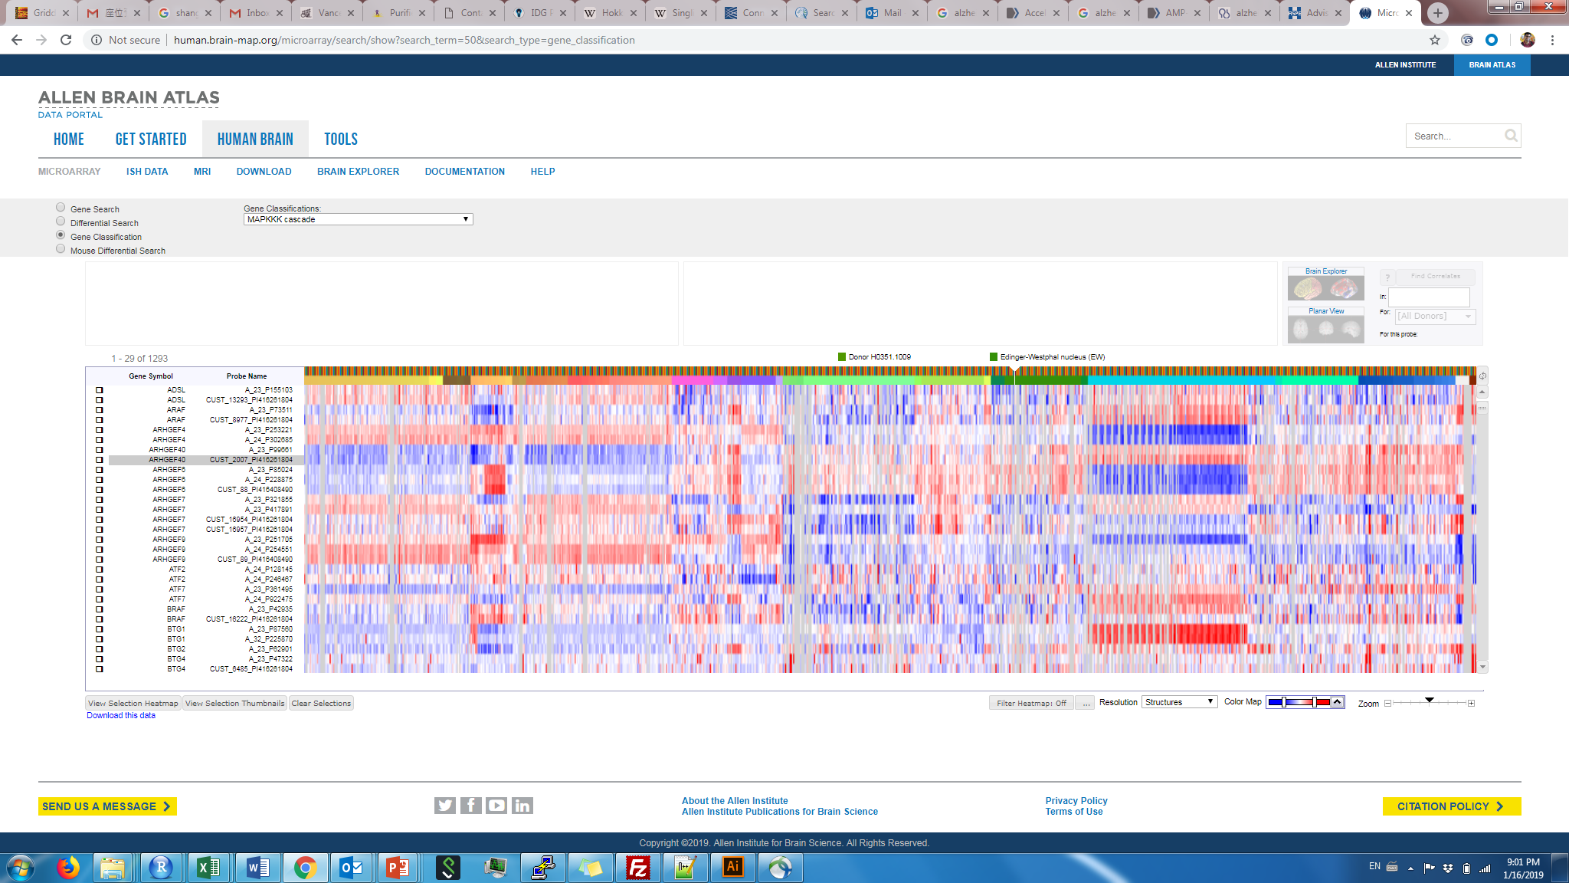
Molecular profiling methods
Method | ISH/IHC | RNA-sequencing
# of genes/proteins at once | ~1 – 5 (~500 with advanced methods) | ~10,000 – 20,000
Single-cell resolution | Yes | No
Spatial information | Yes | No
“Unbiased” (no pre-selection) | No | Yes
Single-cell RNA-seq
~1,000 – 10,000
Yes
No
Yes
Spatial transcriptomics
~1,000 – 10,000
Possible
Yes
Possible

Slide 3
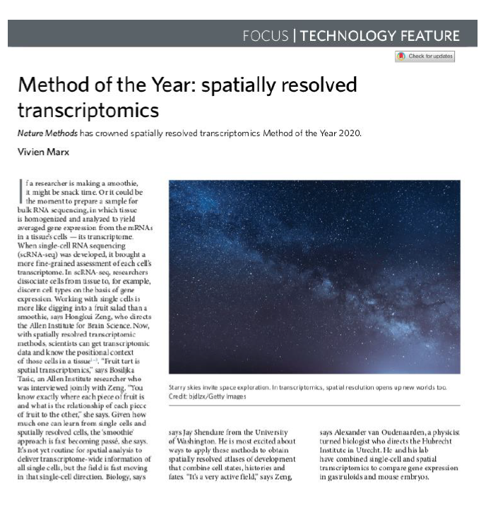
Background
Rapid advancement of ST technologies in the past 5 years
Combines transcriptomics with imaging
Can achieve sub-cellular resolution
Analysis methods need to account for spatial information and sensitivity

Slide 4
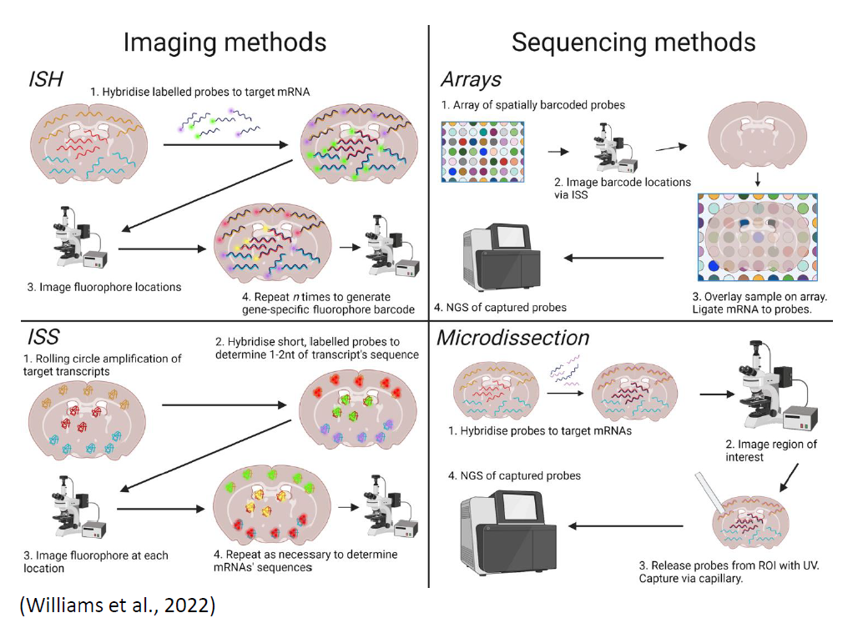
Types of ST platforms
Considerations when selecting an ST platform:
Targeted vs. untargeted (transcriptome-wide)
Compatibility with IHC
Spatial resolution
Throughput

Slide 5
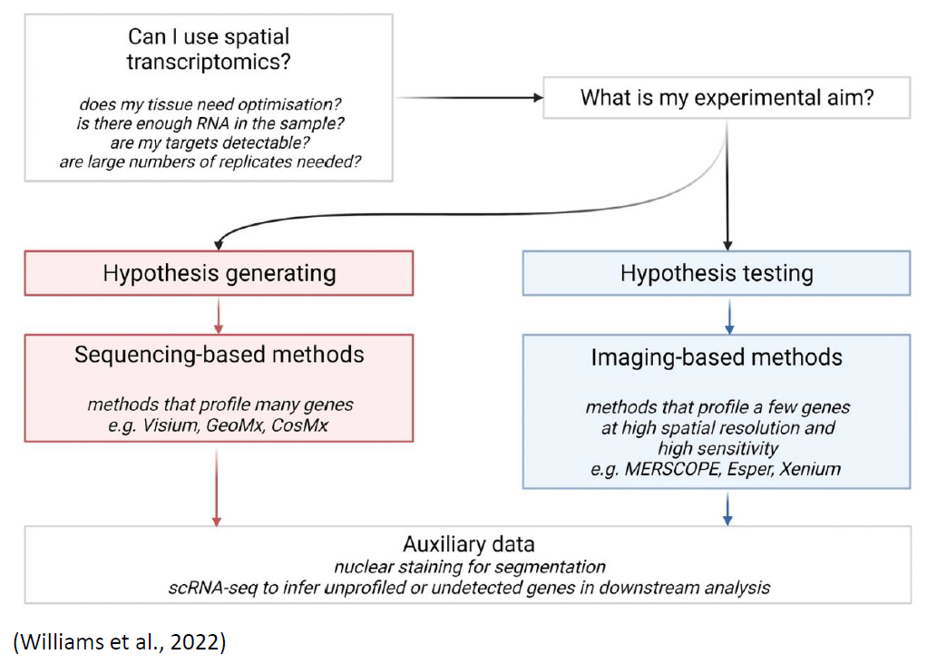
How to choose an appropriate platform

Slide 6
Summary of some available platforms
Platform | Developer | Class | Resolution | # of genes | IHC
GeoMx | Nanostring | Imaging based | 10-20 cells | 1k-18k | Compatible
CosMX | Nanostring | Imaging based | Subcellular | 1k | Integrated (up to 64)
Visium | 10x Genomics | Sequencing based | 55 micron diameter, 110 micron spot-to-spot distance | Transcriptome-wide (often ~5k per spot) | Compatible, but staining first
VisiumHD | 10x Genomics | Sequencing based | 2x2 micron, often aggregated to 8x8 or 16x16 | Transcriptome-wide | Compatible, but staining first
Xenium | 10x Genomics | Imaging based | Subcellular | 480 custom, 5k pre-selected | Compatible, but staining afterwards
MERSCOPE | Vizgen | Imaging based | Subcellular | Up to 1k custom | Compatible, but staining afterwards
Stereo-seq | STOmics | Sequencing based | 0.2x0.2 micron, often aggregated to 25x25 | Transcriptome-wide | Compatible, but staining first
Slide-seq | Curio | Sequencing based | Single nucleus | Transcriptome-wide | Not compatible

Slide 7
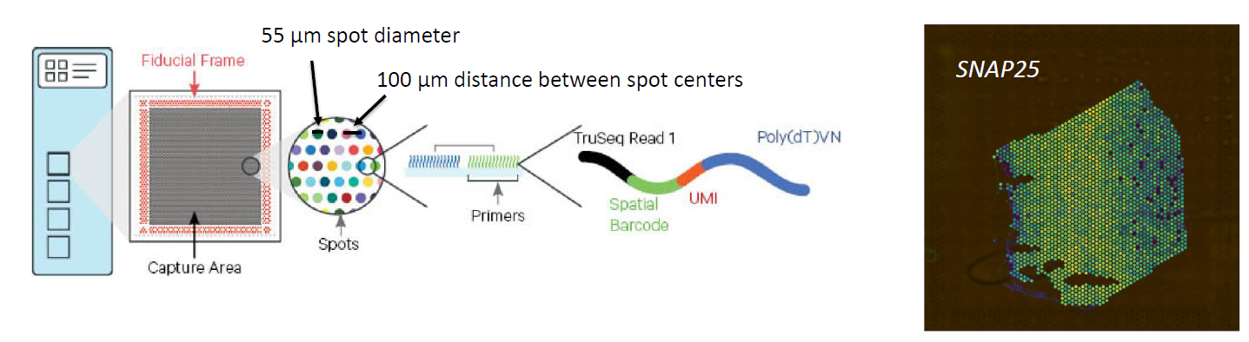
Sequencing-based platform: Visium
Note: VisumHD has 2-micron resolution, but is very new currently

Slide 8
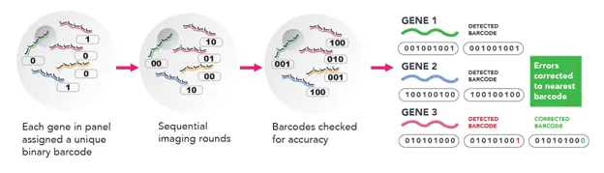
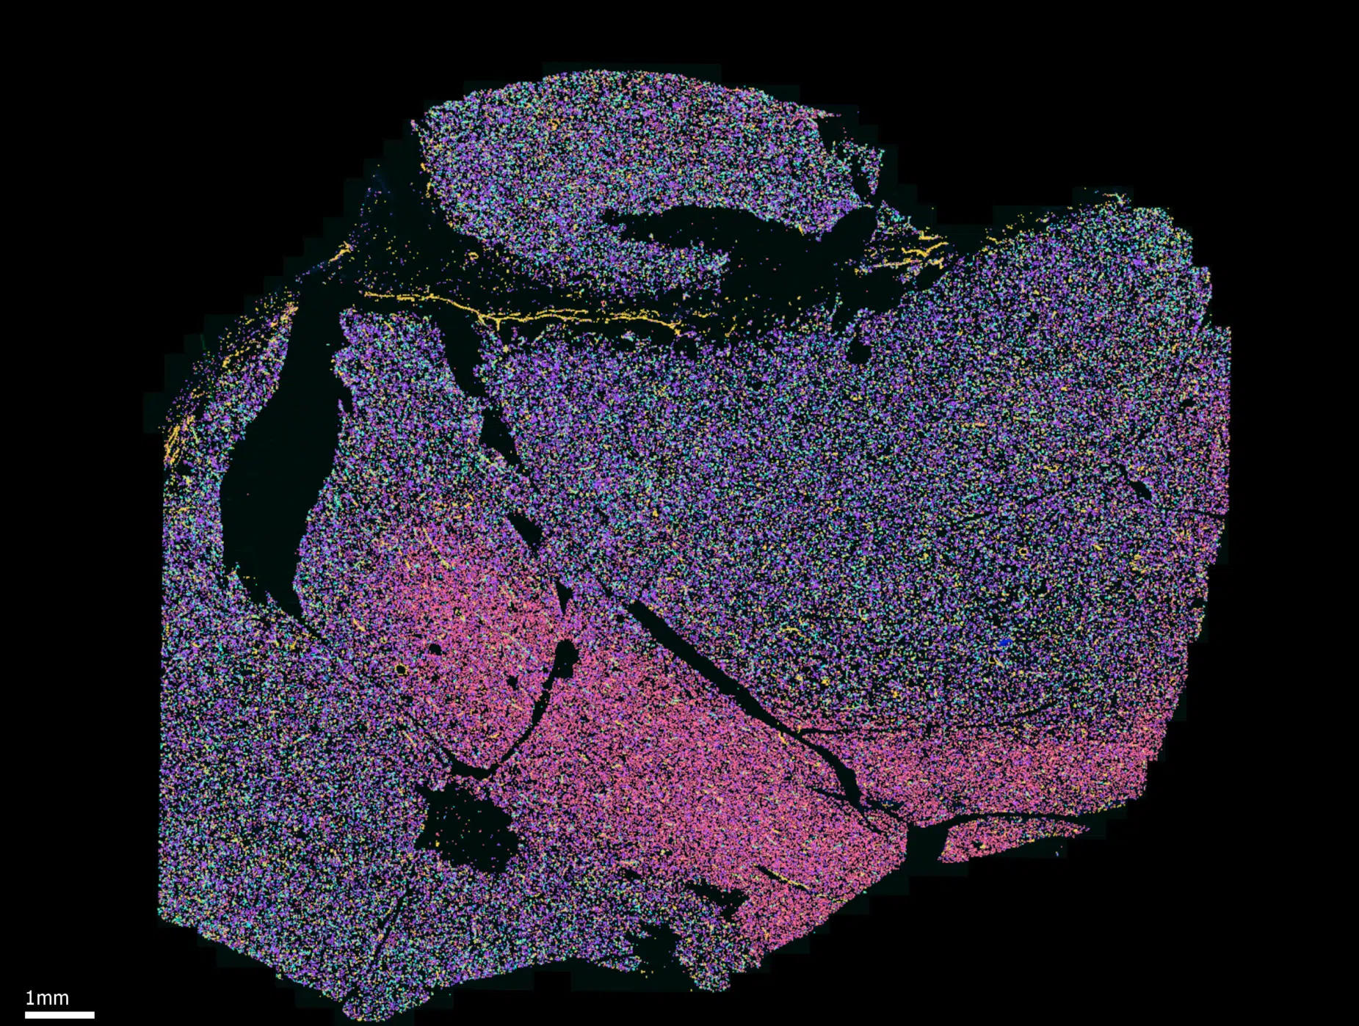
Imaging-based platform: MERSCOPE

Slide 9
Possible analysis questions/workflow
Pre-processing and quality control (platform-dependent)
Analysis 0 (optional for downstream analyses):Assignment of cell type identities
For single-cell resolution methods: transfer labels from reference (RCTD, Seurat, scanVI), or de novo clustering
For non-single-cell methods: spot/ROI deconvolution (Cell2Location, RCTD, etc.)
Analysis 1: Gene clustering
Identifying modes of gene expression with similar spatial patterns across regions and/or conditions (WGCNA, clustering methods)
Analysis 2: Spatial clustering
Identifying regions with similar gene expression/cell type composition patterns (BayesSpace, spaVE)
Analysis 3: Differential gene expression
Identifying differential genes within regions in the same section of tissue (Splotch, SpatialDE2)
Identifying differential genes within regions across multiple conditions (Splotch, Mixed-effect models with spatial priors)
Analysis 4: Spatially variable genes (SVGs)
Identifying genes with spatial patterning in the tissue (SPARK, SpatialDE2, MERINGUE)

Slide 10
QC & Normalization
 | Sequencing-based methods | Imaging-based methods
Initial QC | Similar to single-cell/single-nucleus RNA-seq: Number of Unique Molecular Identifiers (UMIs) per spot Number of genes detected per spot Library saturation/complexity Mitochondrial RNA can be used, but not as informative as in sc/snRNAseq | Nucleus/cell segmentation check (visual) Number of transcripts detected per cell Number of genes detected per cell
Normalization | Differential approaches use count data directly Clustering approaches use data scaled to total UMIs per spot | Can use data scaled to total transcripts per cell Alternatively, transcript number is normalized to cell/nucleus volume

Slide 11
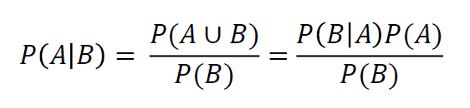
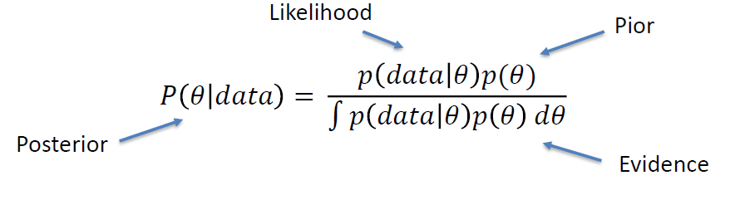
Refresher: Bayesian statistics
Key concept: incorporates prior information and observations to generate a posterior model
Bayes’ rule:
Probability(A, given B) = Probability(B, given A) x Probability(A) / Probability(B)
As a statistical inference model:
Prior

Slide 12
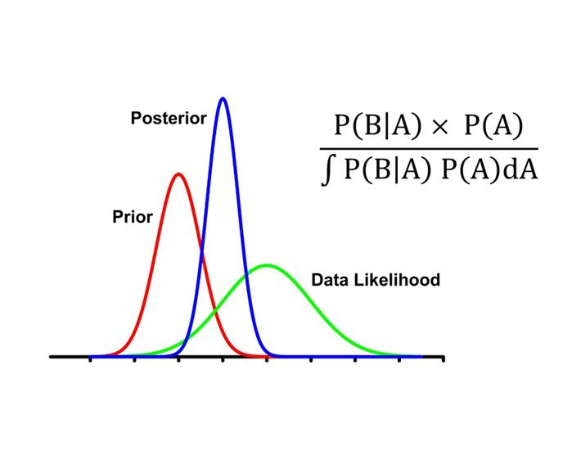
Bayesian statistics: concepts
Instead of a p-value (frequentist statistics), we usually report a Bayes factor
Bayes factor: Ratio of likelihoods of two models
BF = p(data | Model 1) / p(data | Model 0)
No hard limits/cutoffs on BF for “significance”, but BF>10 is an indicator of strong evidence for Model 1 over Model 0
VSNi

Slide 13
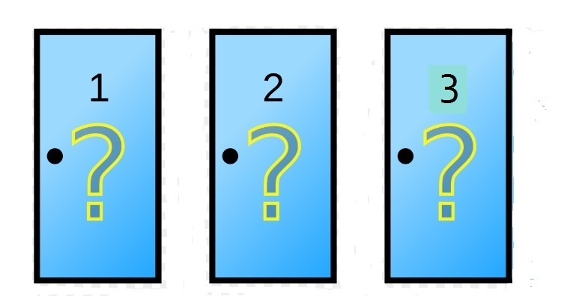


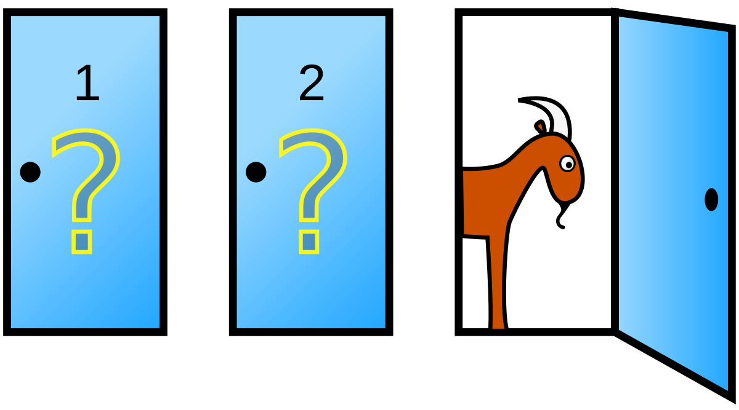
Example: Monty Hall Problem
You are presented with 3 identical doors. Behind one of them is a prize, and behind the other two are goats.
You select the door behind which (you think) the prize is.
USA Today
Monty opens one of the other doors to reveal a goat (always), and offers you the option to switch doors.
He will then open the door you selected to see if you won the prize.
Should you switch doors? Does it make a difference?

Slide 14
Frequentist analysis
No prior information incorporated, so the prize is equally likely to be behind either of the two remaining doors. So it makes no difference if you switch.
USA Today
Monty opens one of the other doors to reveal a goat (always), and offers you the option to switch doors.
He will then open the door you selected to see if you won the prize.
Should you switch doors? Does it make a difference?

Slide 15
Group exercise: Monty Hall problem simulation

Slide 16
Bayesian analysis
P (prize is behind door 2|Monty opens door 3) = P(Monty opens door 3|prize is behind door 2) x P(prize is behind door 2)
P(Monty opens door 3)
Prior: P(prize is behind door 2) = 1/3
Data likelihood: P(Monty opens door 3|prize is behind door 2) = 1 he has no choice
Evidence: P(Monty opens door 3) is complicated – this is the hardest term to calculate in most Bayesian models
P(Monty opens door 3|prize is behind door 1) x P(prize is behind door 1) = 1/2 x 1/3
P(Monty opens door 3|prize is behind door 2) x P(prize is behind door 2) = 1 x 1/3
P(Monty opens door 3|prize is behind door 3) x P(prize is behind door 3) = 0 x 1/3
Total: 1/6 + 1/3 + 0 = 1/2
Posterior: 1/3 x 1 = 2/3
1/2
Should you switch doors? Does it make a difference?

Slide 17
Why use Bayesian approaches in spatial transcriptomics?
Underlying assumption: locations in tissue that are close to each other have more similar gene expression patterns
Why?
Most solid tissues have some aspect of regional organization associated with biological function, development, or redundancy
Individual may span multiple neighboring regions
Bayesian approaches can incorporate spatial information to:
Better model differential expression across regions or conditions (increased power without false positives)
Approximate/impute gene expression in noisy data

Slide 18
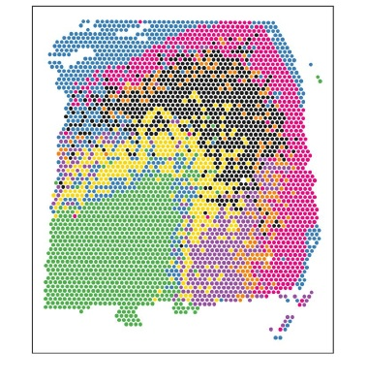
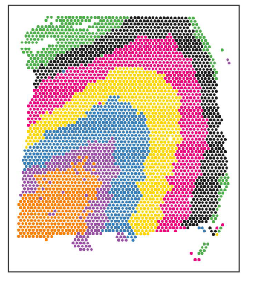
Spatial clustering analysis
Goal: assign each individual spot a region label (analogous to “cell types” in single-cell data)
Single-cell clustering methods (e.g. PCA + Louvain clustering) can be applied, but do not use spatial information
Human cortex (Visium), with spots clustered using PCA + Louvain clustering
Prior/Likelihood: red spot is more likely to have the same cluster identity as neighboring blue spots
How can we incorporate spatial information?
Use a spatial prior/likelihood: neighboring spots are more likely to have the same cluster identity
Human cortex (Visium), with spots clustered using BayesSpace

Slide 19
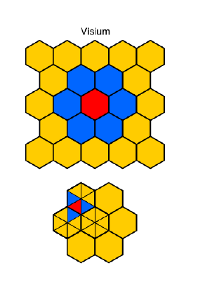
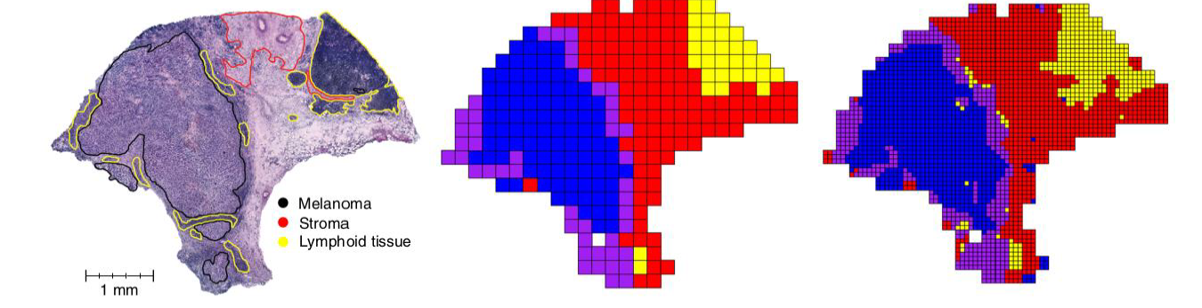
Further applications of BayesSpace
Bayesian approaches can be extended to provide sub-spot resolution inference
Subspot expression values are allowed to jitter, so long as total expression of the spot is maintained
With higher-resolution methods, this is no longer needed, but still useful on older lower-resolution methods
Zhao et al. Nature Biotech (2021)

Slide 20
Review of analyses
Pre-processing and quality control (platform-dependent)
Analysis 0 (optional for downstream analyses):Assignment of cell type identities
For single-cell resolution methods: transfer labels from reference (RCTD, Seurat, scanVI), or de novo clustering
For non-single-cell methods: spot/ROI deconvolution (Cell2Location, RCTD, etc.)
Analysis 1: Gene clustering
Identifying modes of gene expression with similar spatial patterns across regions and/or conditions (WGCNA, clustering methods)
Analysis 2: Spatial clustering
Identifying regions with similar gene expression/cell type composition patterns (BayesSpace, spaVE)
Analysis 3: Differential gene expression
Identifying differential genes within regions in the same section of tissue (Splotch, SpatialDE2)
Identifying differential genes within regions across multiple conditions (Splotch, Mixed-effect models with spatial priors)
Analysis 4: Spatially variable genes (SVGs)
Identifying genes with spatial patterning in the tissue (SPARK, SpatialDE2, MERINGUE)

Slide 21
Exercise

